Slide 1
SENTIMENT ANALYSIS OF ONLINE CUSTOMER REVIEWS
Project Group 1
Saugat Adhikari, Krishna Gahatraj, Shusma Kafle, Jing Wu, Lyuheng Yuan
Department of Computer Science
The University of Alabama at Birmingham

Slide 2
Introduction and Motivation
•Determine user sentiment from reviews
•Positive, Negative, or Neutral sentiment
•Use Data Mining techniques to classify the sentiment
•Buying decision based on historical reviews

Slide 3
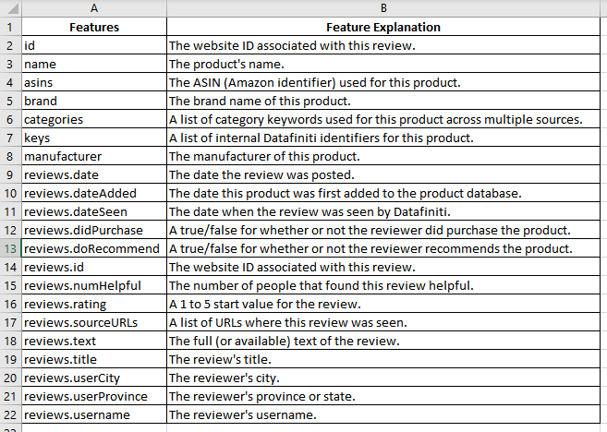
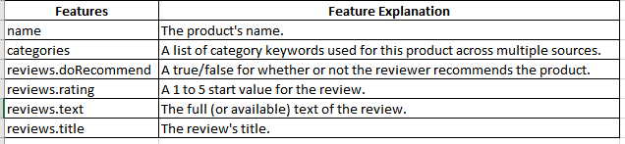
Amazon Online Customer Review Dataset
------ downloaded from Kaggle
6 Features * 34,660 Rows
21 Features * 34,660 Rows

Slide 4
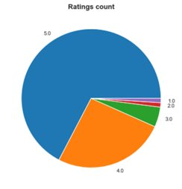
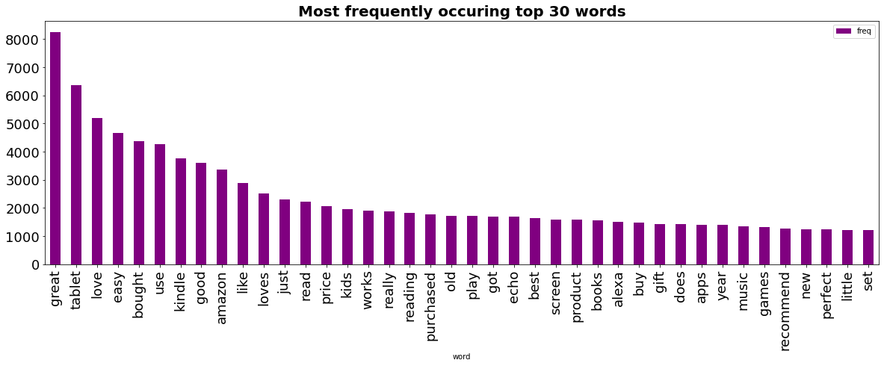
Visualization

Slide 5
Oversampling
Handle class imbalance problem
SMOTE(Synthetic Minority Oversampling Technique)
Oversample minority classes like negative and neutral by generating synthetic data

Slide 6
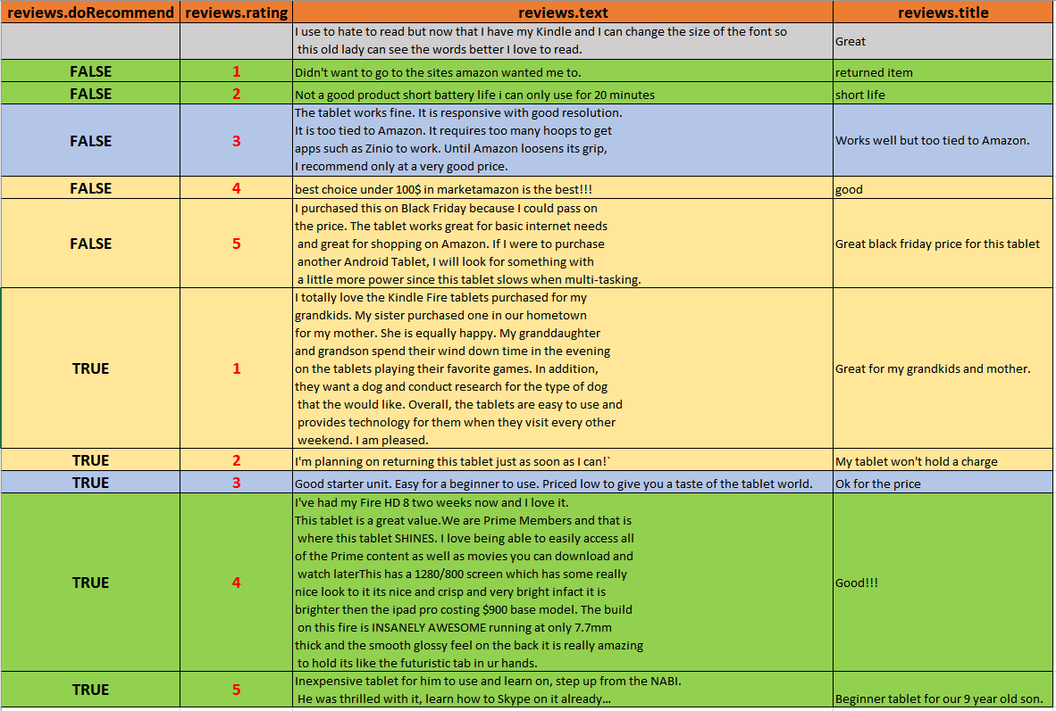
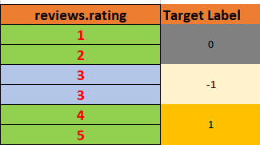
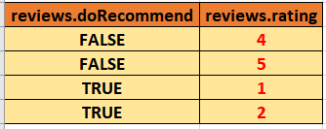
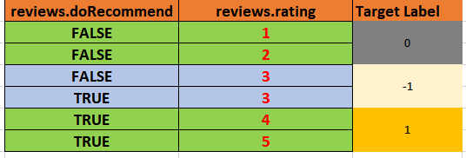
Amazon Online Customer Review Dataset Preprocessing
1. Discard Reviews with no ratings
34,660 rows ---> 27,407 rows
2. Label Dataset
Negative
Neutral
Positive
Shape (27407, 7)
3. Drop Inconsistent Reviews
4. Convert text String into a list of clean tokens
Dataset with consistent Reviews for Analysis
Inconsistent Reviews

Slide 7
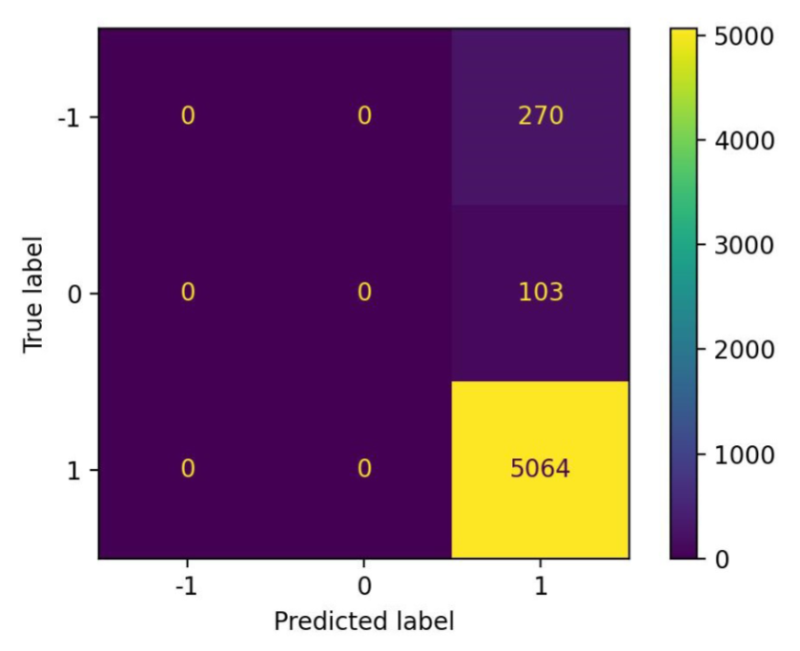
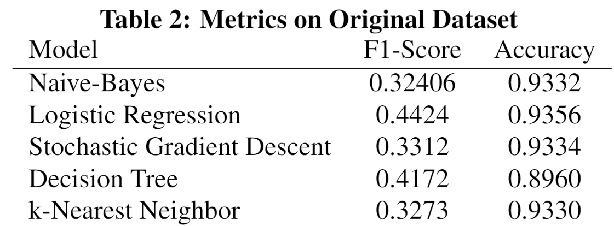
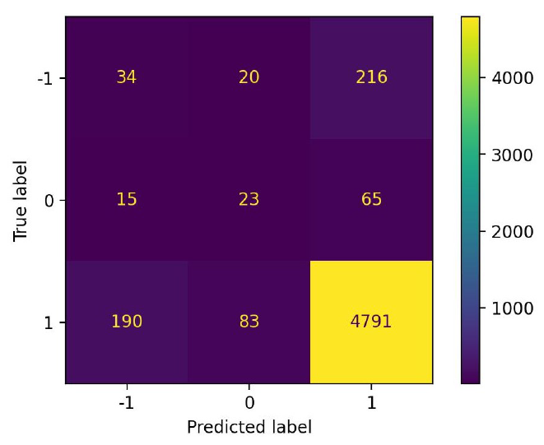
Models Training and Results
Machine Learning Models
Confusion Matrix for Naïve Bayes Classifier on Original Dataset
Confusion Matrix for Decision Tree Classifier on Original Dataset

Slide 8
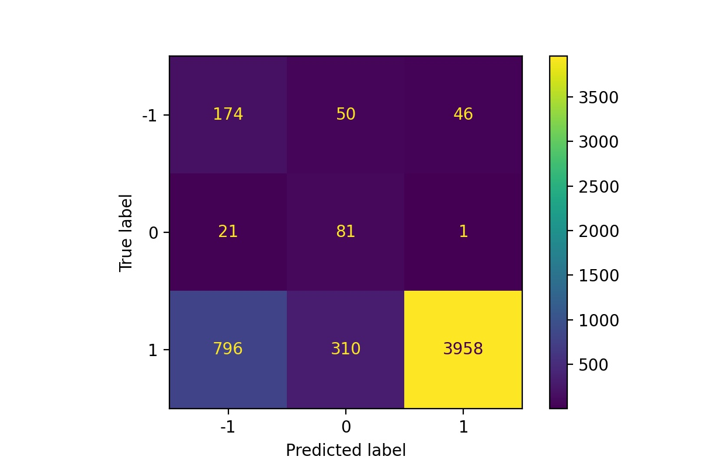
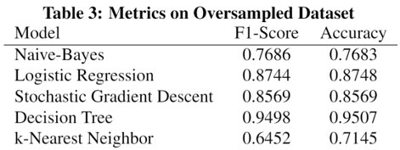
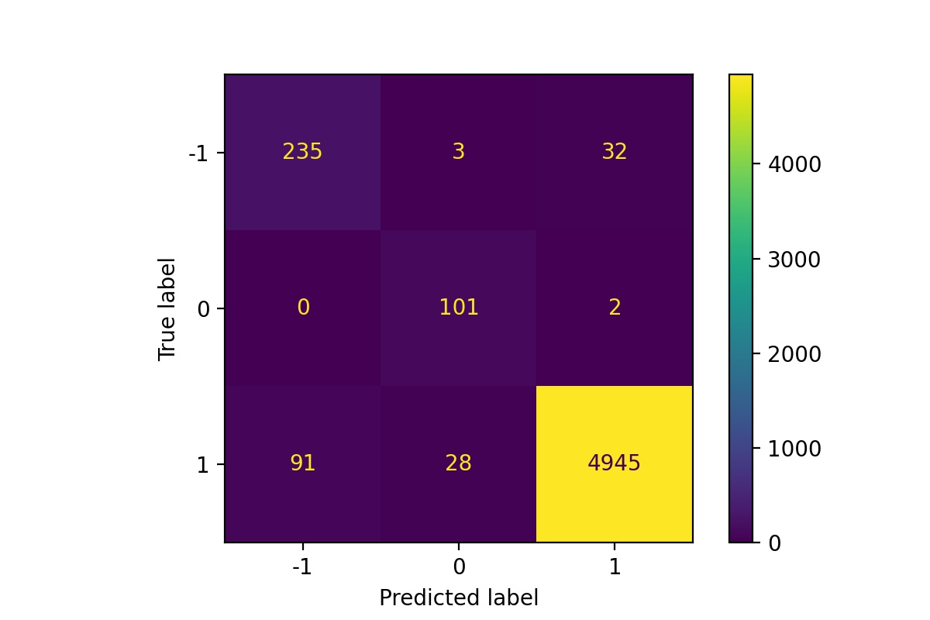
Machine Learning Models(cont.)
Confusion Matrix for Naïve Bayes Classifier on Oversampled Dataset
Confusion Matrix for Decision Tree Classifier on Oversampled Dataset

Slide 9
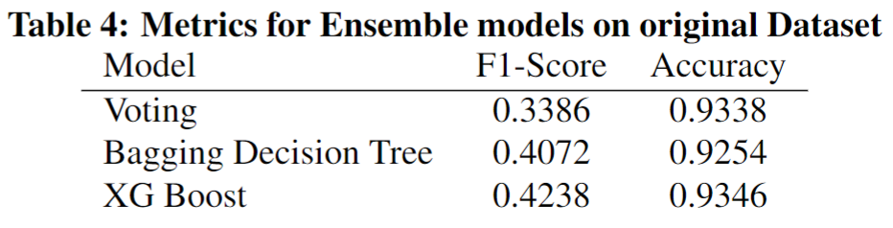
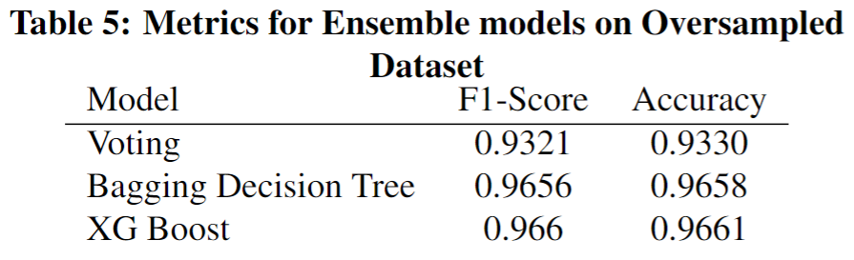
Ensemble Models

Slide 10
Deep Learning Models
Dataset | F1-score | Accuracy
Original | 0.4718 | 92.75%
Oversample | 0.9891 | 98.91%
Positive
Neutral
negative
100
400
1000
Cross Entropy Loss
Adam optimizer
LR = 0.01
Train 20 Epochs

Slide 11
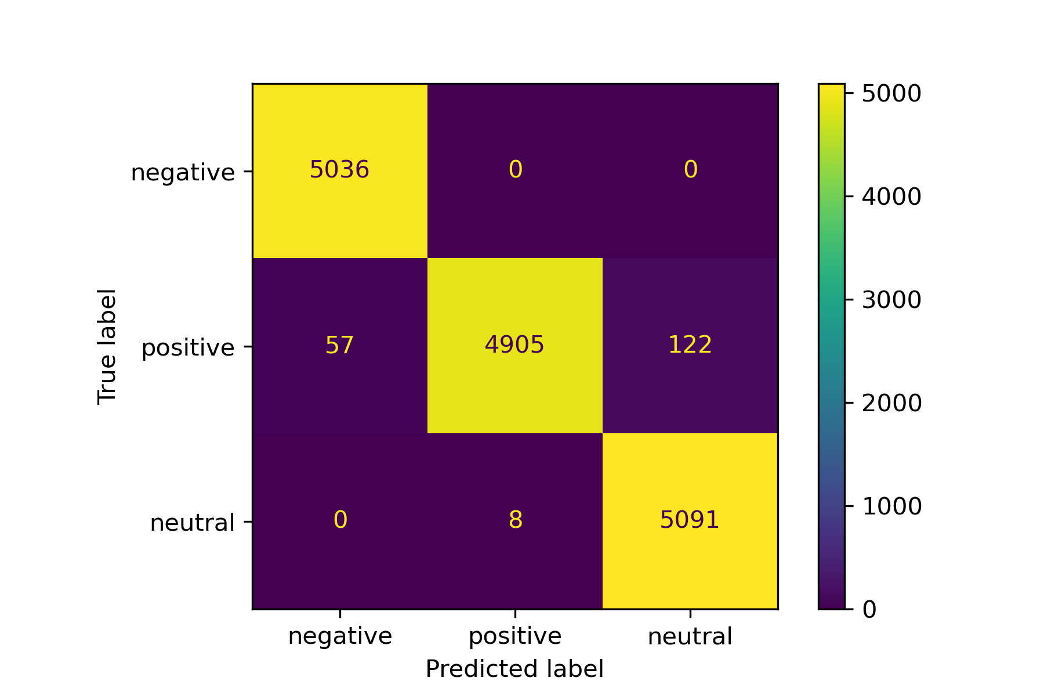
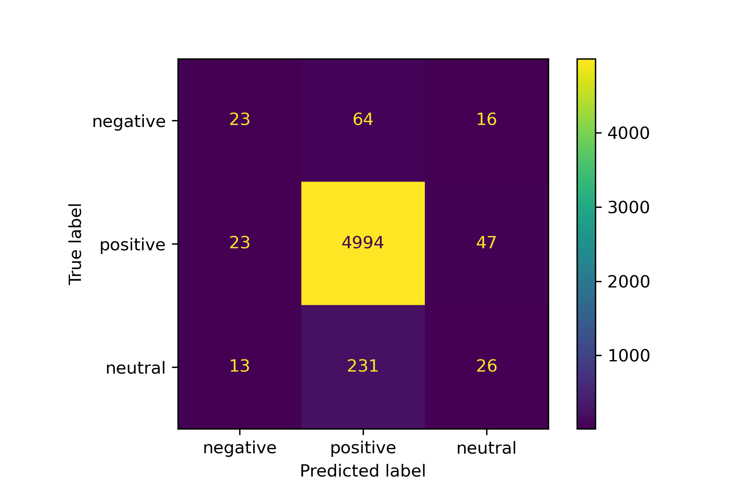
Confusion Matrix for Deep Learning on Oversampled Dataset​
Confusion Matrix for Deep Learning on Original Dataset​

Slide 12
Future Works
Develop a recommendation system
Decide whether to recommend a product based on historical reviews

Slide 13
Thank you!

